Slide 1
HANDWRITTEN DIGIT RECOGINITION
Submitted by:- Prabhleen Kaur
Net ID- jx3874

Slide 2
INTRODUCTION
Handwritten digit recognition is Data Analysis on load_digits dataset of sklearn using Random Forest Classifier.
It helps us predict the digit in dataset.
Dataset made up of 8*8 images, each transformed into a feature vector of length 64.
Classes | 10 (0-9 digits)
Samples per class | ~180
Samples total | 1797
Dimensionality | 64
Features | integers 0-16

Slide 3
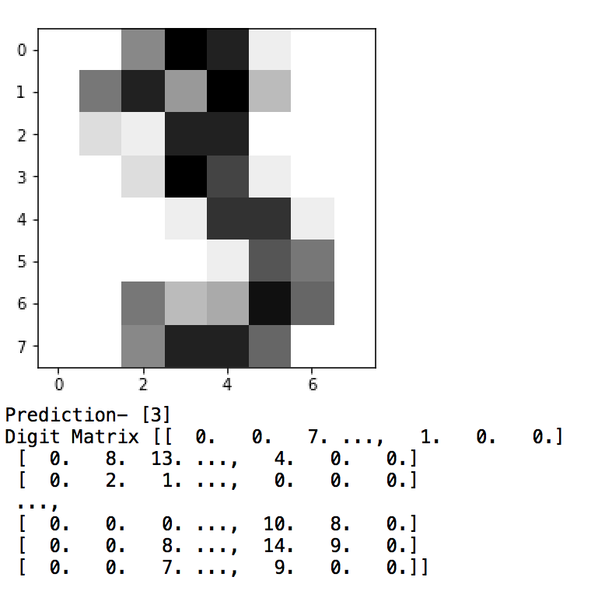
Pythons sees every single digit as a matrix of 8*8
Example of digit 3 is shown with prediction, image and matrix.
Each element represent the pixel of gray scale image
Element of matrix varies from 0 to 255 indicating the colors (0 for white and 255 for black)

Slide 4
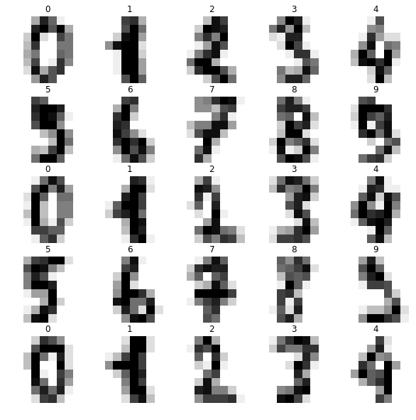
First 25 digits in the dataset with predictions
First 25 digits in load_digits dataset where generated as output
As seen mostly all the digits are predicted correct.
Furthermore, calculating the prediction score using Random Tree Classifier.
Prediction score can be calculated analysing validation_images, validation_target arguments.
Validation_images means the images of human handwritting and Validation_target are the pre-determined numbers.

Slide 5
Prediction Score by Random Tree Classifier
Digit (0-9) | Prediction Score
0 | 90.47%
1 | 88.53%
2 | 89.36%
3 | 86.58%
4 | 86.93%
5 | 88.18%
6 | 88.11%
7 | 89.85%
8 | 86.51%
9 | 86.51%

Slide 6

Apart from that, the total number of digits calculated are 1797
There are decision trees generated for each digit to represent the learned function.

Slide 7
SUMMARY
Project analysis every single digit in the dataset and predicts the digit
Random Forest classifier is one of the most accurate learning algorithm available
Overfitting is one problem of Random Forest.

